Slide 1

CS 533 INTRO TO DATA SCIENCE
Michael Ekstrand

Slide 2
REGRESSION

Slide 3

Learning Outcomes
Compute a linear regression with one predictor
Photo by Andre Benz on Unsplash

Slide 4
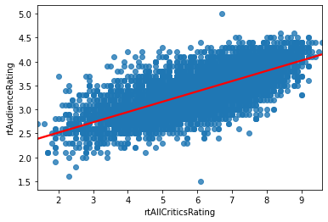
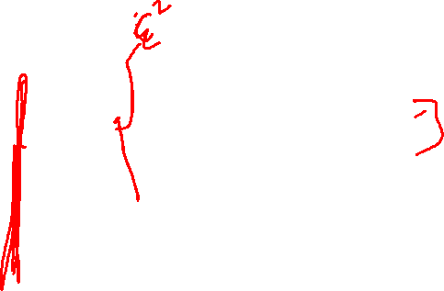
Trend Line
Where did this come from?

Slide 5
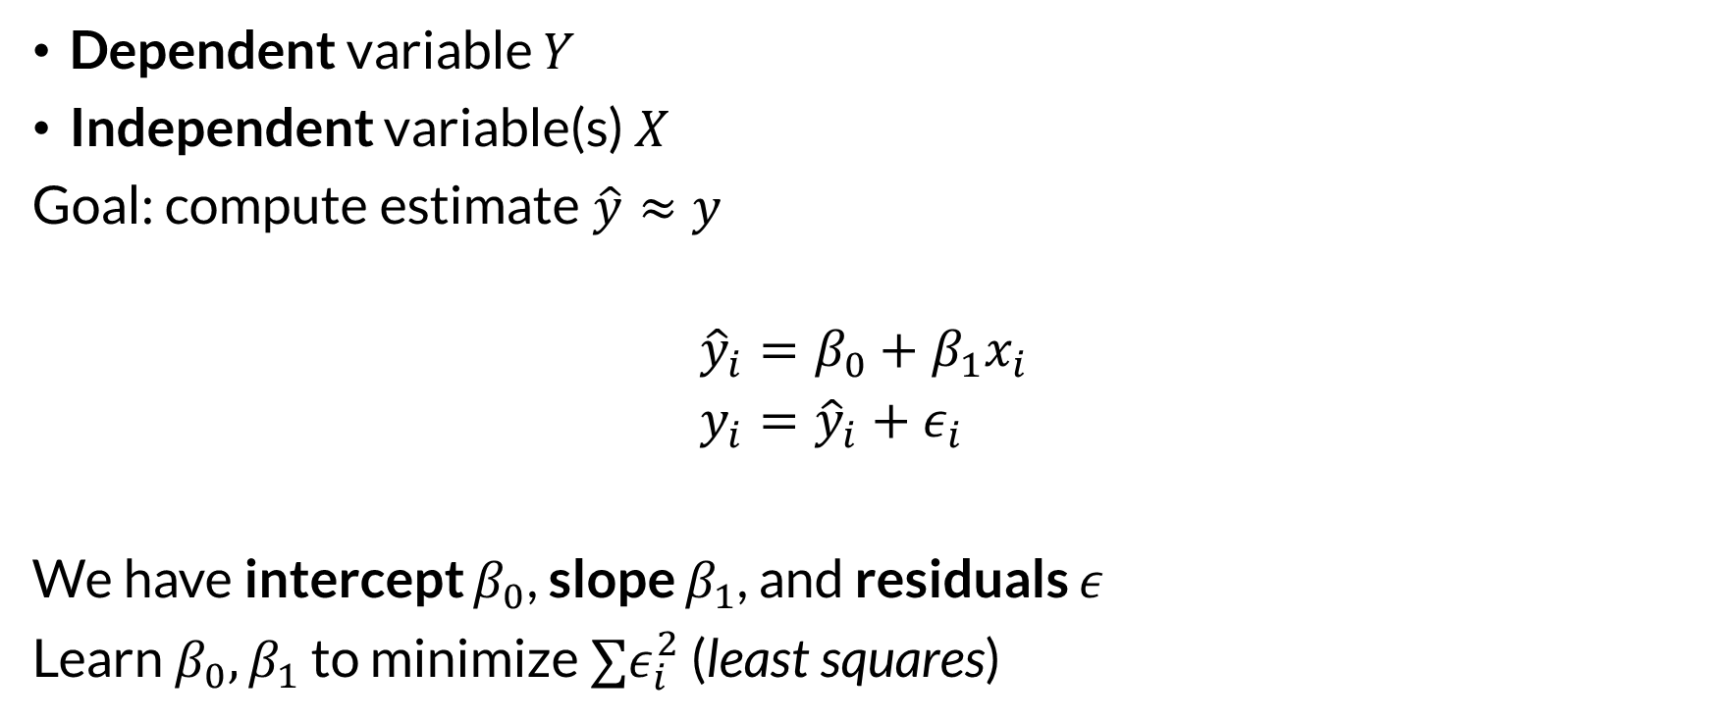
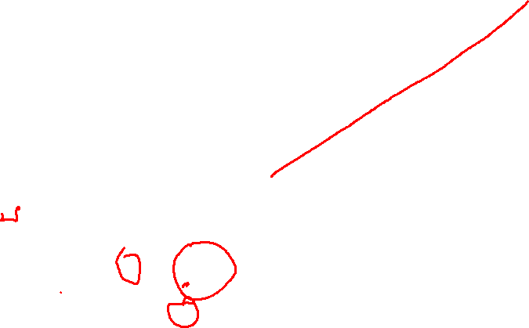
Variables and Model
Dependent variable $Y$
Independent variable(s) $X$
Goal: compute estimate $\hat{y}≈y$
$${\hat{y}}_{i}=β_{0}+β_{1}x_{i} \\ y_{i}={\hat{y}}_{i}+ε_{i}$$
We have intercept $β_{0}$, slope $β_{1}$, and residuals $ε$
Learn $β_{0},β_{1}$ to minimize $∑ε_{i}^{2}$ (least squares)

Slide 6
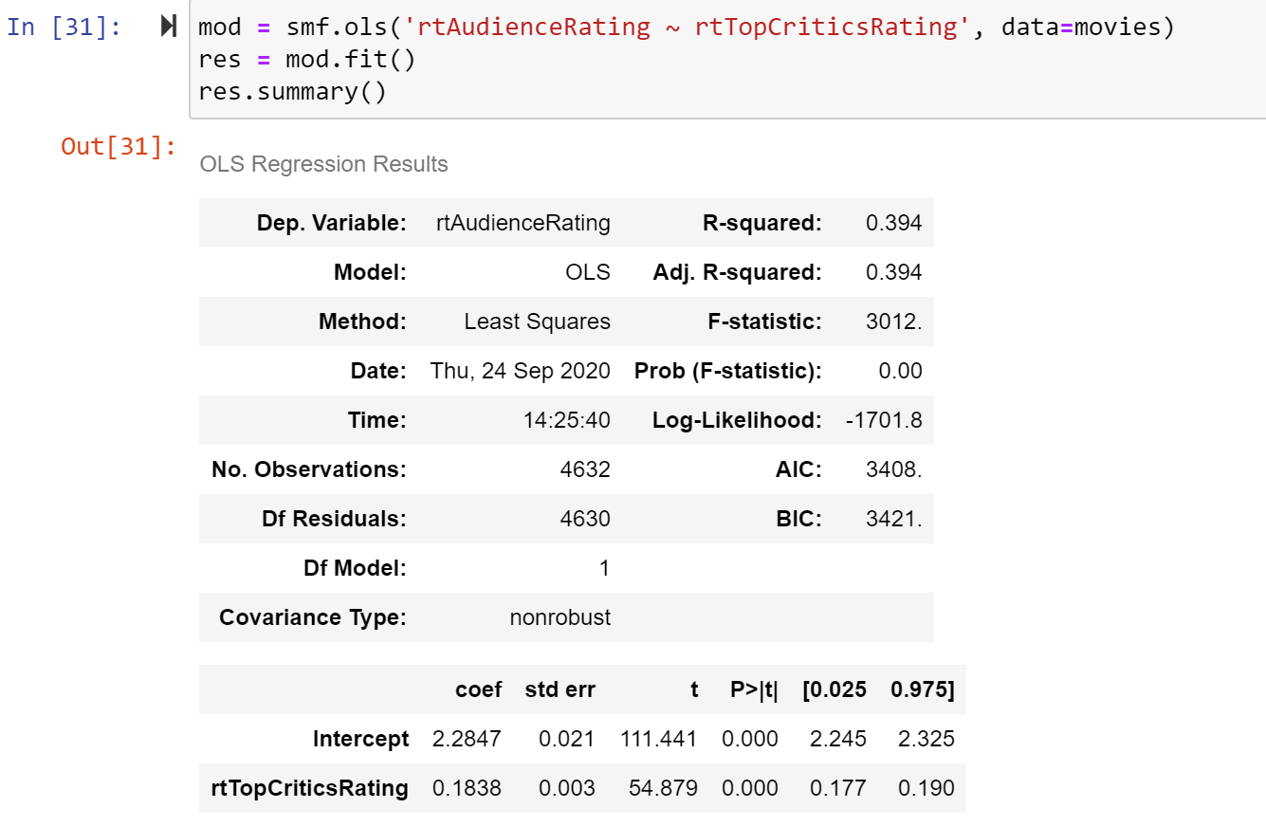
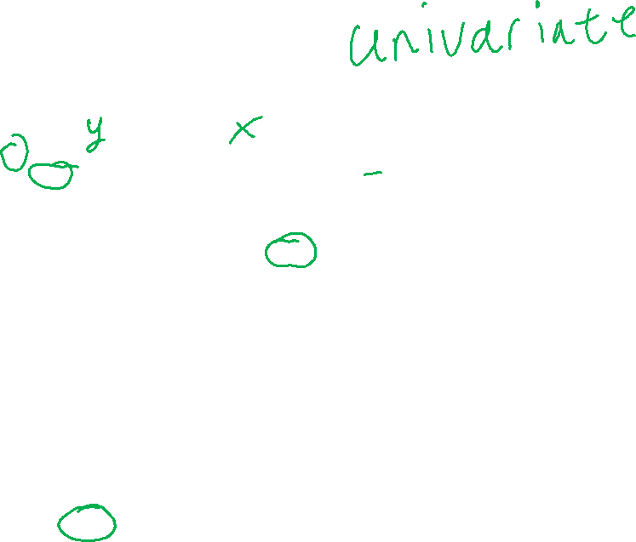
Regression Model
coef – strength of relationship
R² – frac. of variance explained
Ignore p-values and standard errors for now

Slide 7

Wrapping Up
Regression predicts one value with another.
Lets us go beyond same-scale (paired t-test) to determine strength of relationship.
Photo by Lucy-Claire on Unsplash

